Slide 1

World Airbnb
Hawaii

Slide 2
Your best quote that reflects your approach… “It’s one small step for man, one giant leap for mankind.”
- Neil Armstrong

Slide 3

Objective
Identify the attributes that make Airbnb “Successful”
Find the best place to stay in Hawaii

Slide 4

Hypothesis
Ho:
The number of properties rented out by a host has no impact on rating.
H1:
if a host has a high number of properties then their ratings are not higher than hosts with fewer properties
None of the factors we are analyzing (neighborhood, number of listings per host, room type, price, keywords in description, how long the host has been hosting, and certain amenities) have an impact on the overall rating.

Slide 5
Analysis
Evaluate the relationship:
Age of property, ratings per month and price.
Number of properties per host and ratings.
number of bedrooms and bookings per month.
neighborhoods and bookings per month.

Slide 6


Analysis
Identify:
Variable that has more impact in the best value and best price.
Variables: neighborhood, type of place
Impact of the name in the number of booking
Trigger words in the name that relate to higher bookings

Slide 7
Hypothesis
Ho:
Null Ho:
if a host has a high number of properties then their ratings are not higher than hosts with fewer properties

Slide 8
Hawaii Airbnb Dependencies
X
y

Slide 9
Hawaii Airbnb Data preparation
X
y

Slide 10
Hawaii Airbnb Define variables
X
y

Slide 11
Hawaii Airbnb Results
X
y

Slide 12
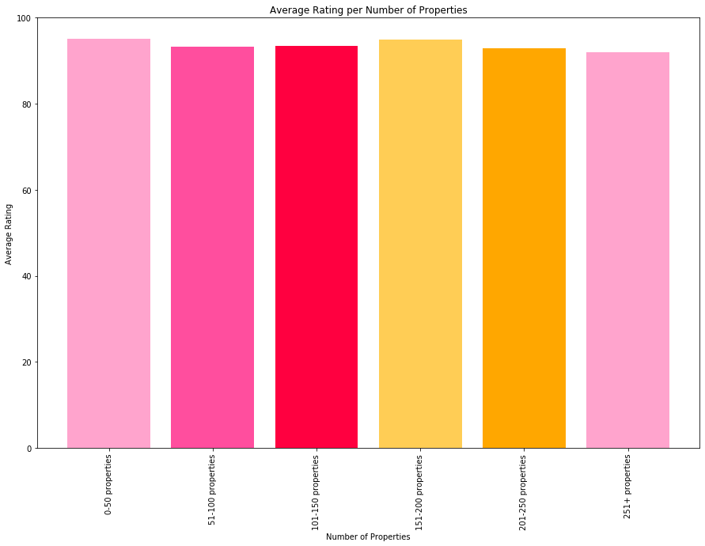

Slide 13
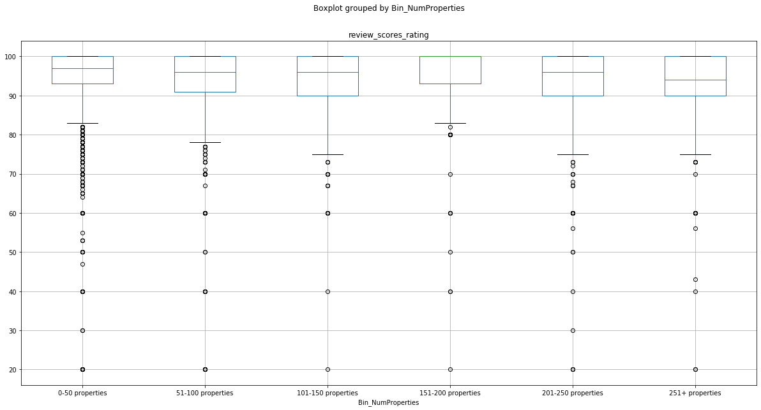

Slide 14
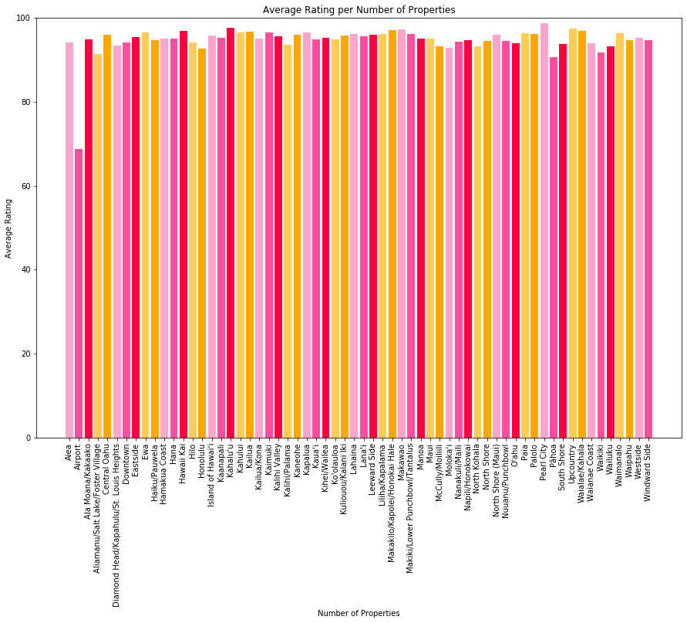

Slide 15
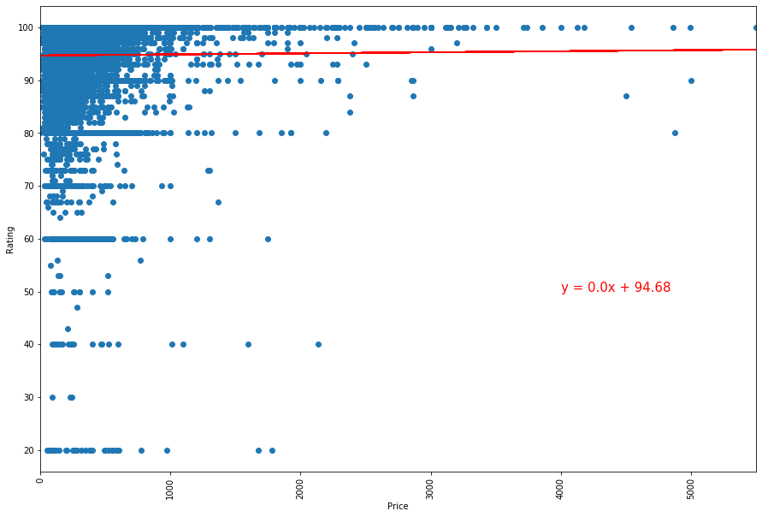

Slide 17
Hawaii Airbnb Conclusion
X
y

Slide 18
Hawaii Airbnb Recommendation
X
y

Slide 19

The Scam
Critical Inside

Slide 20



